Slide 1
D-Star Introduction
Max Polishevsky VE6MAD
Ian Burgess VA6EMS

Slide 2
What is D-STAR?
Digital Smart Technology for Amateur Radio
JARL
Japanese Amateur Radio League
NOT Manufacturers!
Goal
Advancement of the hobby
Spectrum Efficiency
Experiment with Simultaneous Voice and Data
D-STAR Gateway owned by Icom
Not Public Domain or Open Source
May not be copied, shared or redistributed

Slide 3
Why is D-STAR interesting?
Spectral Efficiency
Simultaneous Voice and Data capability
2m/70cm/23cm
High-Speed Data capability
23cm
Internet Linking capability
Microwave Linking capability

Slide 5
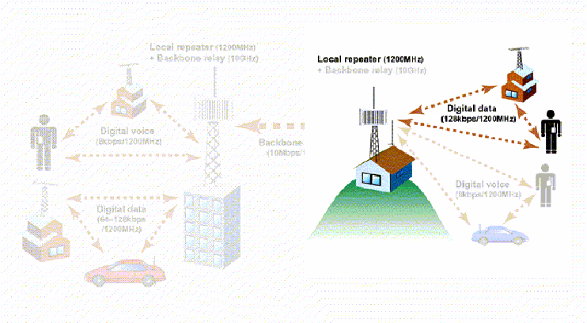

Slide 6
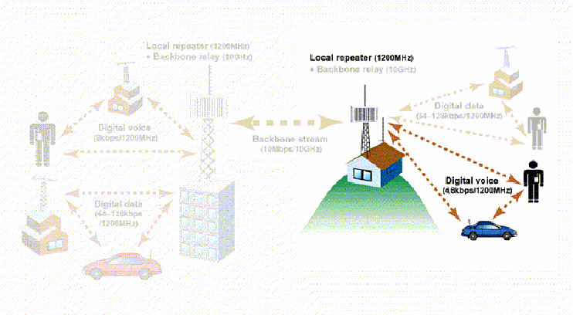

Slide 8
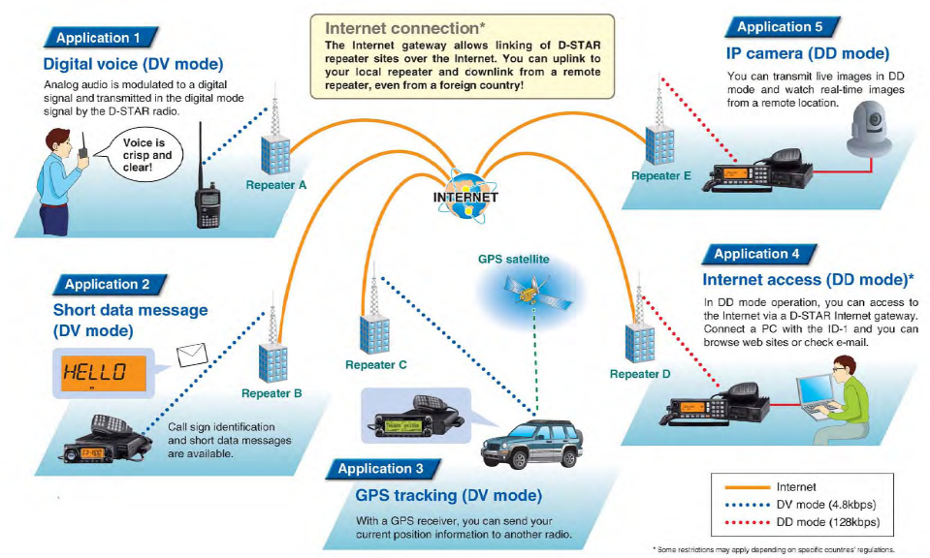

Slide 9
Why is D-STAR interesting?
Spectral Efficiency
6.25 kHz emission
10 kHz channel spacing (reasonable)
More efficient use of available bandwidth
Allows more channels in crowded spectrum
Better performance compared to analog FM
Same power in less bandwidth (SSB vs. AM)

Slide 10
Terminology
AMBE
Advanced Multi-Band Excitation (AMBE) is a very powerful proprietary speech coding standard developed by Digital Voice Systems, Inc. (From: http://en.wikipedia.org/wiki/Advanced_Multi-Band_Excitation)
Converts audio to and from the digital format used in D-Star Digital Voice at 2400 bps with 1200 bps of FEC.
FEC
Forward Error Correction

Slide 12
Why is D-STAR interesting?
Simultaneous Voice and Data capability
2m, 70cm, 23cm Digital Voice Mode
4800bd Data Stream
2400bd Digital Voice
1200bd FEC on Digital voice
1200bd Serial Data

Slide 14
The DV Protocol
Radio Header
Data
Bit Synchronization 64 bits
Frame Sync
15 bits
Flag 1
8 bits
Flag
2
8 bits
Flag
3
8 bits
Radio ID
P_FCS
Destination Repeater Call 64 bits/8 char
Local Repeater Call 64 bits/8 char
Destination Station Call 64 bits/8 char
This Station Call
64 bits/8 char
This Station Comment 32 bits/4 char
W7SP B
W7SP A
CQCQCQ
K7VE
JOHN

Slide 15
The DV Protocol
Radio Header
Data
Audio Frame
72 bits
Data Frame
24 bits
Final Data Frame
48 bits
Alternating Audio/Data

Slide 16
Why is D-STAR interesting?
High-Speed Data capability
23cm
128kb Ethernet
Transparent Bridge
Allows Network-Agnostic Applications!
Half-Duplex
Duplex-sensitive apps don’t work well (VOIP, etc.)

Slide 17
The DD Protocol
Radio Header
Length
16 bits
Ethernet Style Packet
Bit Synchronization 64 bits
Frame Sync
15 bits
Flag 1
8 bits
Flag
2
8 bits
Flag
3
8 bits
Radio ID
P_FCS
Destination Repeater Call 64 bits/8 char
Local Repeater Call 64 bits/8 char
Destination Station Call 64 bits/8 char
This Station Call
64 bits/8 char
This Station Comment 32 bits/4 char
W7SP B
W7SP A
CQCQCQ
K7VE
JOHN

Slide 18
The DD Protocol
Radio Header
Length
16 bits
Ethernet Style Packet
MAC Src Addr
48 bits
MAC Dest Addr
48 bits
Type
16 bits
Data Frame
128 – 12000 bits
FCS
32 bits
TCP/IP

Slide 19
Why is D-STAR interesting?
Internet Linking capability
User linking vs. Site linking
Can cause confusion for uninformed (example later)
Allows “roaming”

Slide 20
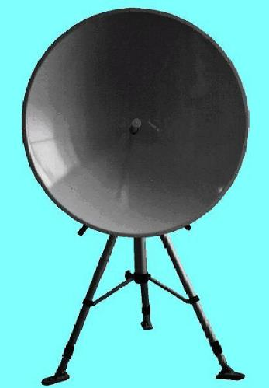
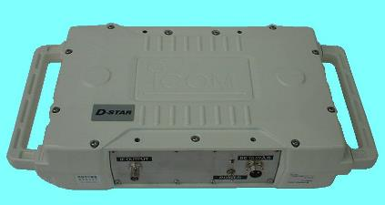
Why is D-STAR interesting?
Microwave linking capability
Install additional regional site(s)
Allows extra connectivity without need for additional Gateway server or additional internet connections
Expensive – approx $5k per and 2 needed

Slide 21
D-Star Radio Products

Slide 22
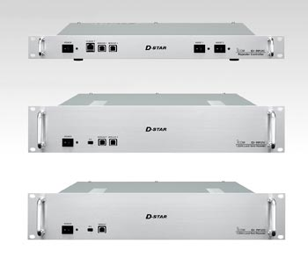
Icom D-STAR Controller & Repeaters

Slide 23
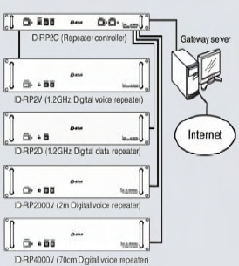
Typical “Full” Stack

Slide 24
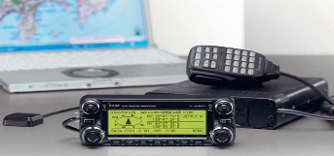
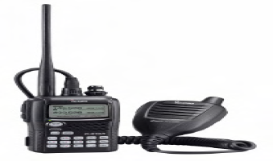
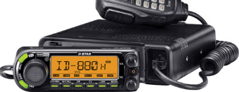
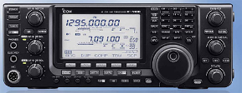
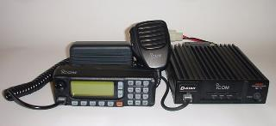
Icom D-Star Radio Products
IC-2820AH
ID-31A
ID-880AH
IC-80AD
IC-91AD
IC-92AD
ID-1
IC-9100

Slide 25
New Applications
Hardware
μSmartDigi™ D-Gate
DV Dongle

Slide 26
μSmartDigi™ D-Gate
Black box translator
D-PRS ® to APRS
APRS to D-PRS®
Smooth RF integration of both systems

Slide 27
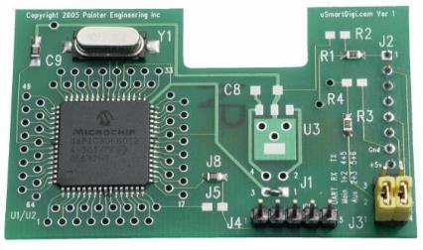
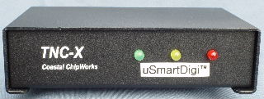
Fits inside a small box
Converts D-STAR NMEA GPS data to Base-91 compressed APRS® Position Reports
Converts Symbol and Text Data
Filters messages according to a rich set of user-configurable rules
Operates without a dedicated laptop or PC

Slide 28
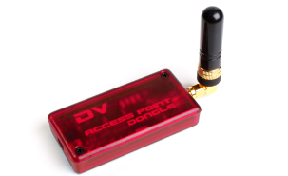
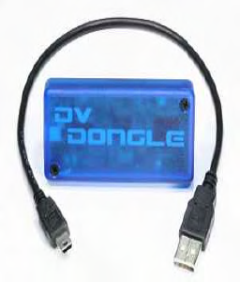
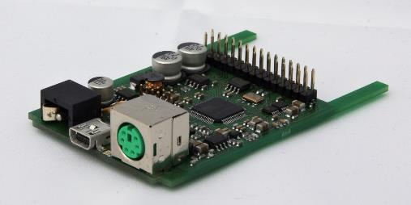
Third Party Products
DV Acccess Point (DVAP)
(VHF Radio-to-Internet Interface)
DV Dongle
(No Radio Required)
DVRPTR Open Source Hotspot Modem

Slide 29
D-STAR TNC
An APRS and D-STAR software bridge
Java Based package
www.aprs-is.net/dstartnc2.htm
DStarTNC2 is free for use by Amateur Radio operators for Amateur Radio.

Slide 30
D-RATS Free Software
A Communications Tool For D-STAR

Slide 31
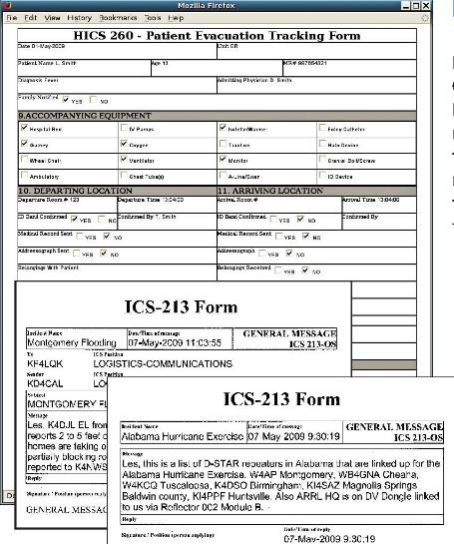
D-RATS Forms
Includes Form Editor to Create Any Form
Only Data is Sent
Fully printable ICS-213, ARRL Radiogram and NTS Forms Included

Slide 32
Summary
Lots of potential for use of simultaneous voice & data
Spectral efficiency offers opportunity for better utilization
Better performance from narrow spectrum & FEC
Distinct operational differences from familiar FM
New applications will drive acceptance
EmComm demand for tactical voice and data communications by served agencies

Slide 33
VE6IPG Proposal
“Inter-connected” system (D-Star, FreeStar*, IRLP, EchoLink, VoIP, AllStar*)
Seamless reflector linking (L,U VS X,O)
RF Improvements
Will be 1 of 2 Multimode Systems Canada Wide
Emergency Prepared System

Slide 34
RF
VE6IPG, Calgary
DVDongle + Server
=
Multi-Mode System
EchoLink
FreeStar*
IRLP
D-Star
AllStar*
FM**
** FM Analog in the Digital World is frowned upon, but is here to demonstrate the full potential of a multi-mode system.

Slide 35
Some Useful Web Sites
www.icomamerica.com/support/forums
www.K5TIT.Org/Forum
Some D-STAR Web Sites:
http://www.d-starusers.org/
http://www.d-rats.com/
www.aprs-is.net/dstartnc2.htm

